Slide 1
Calculated Fields
Quiz

Slide 2
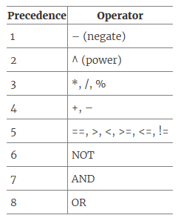
Operators

Slide 3
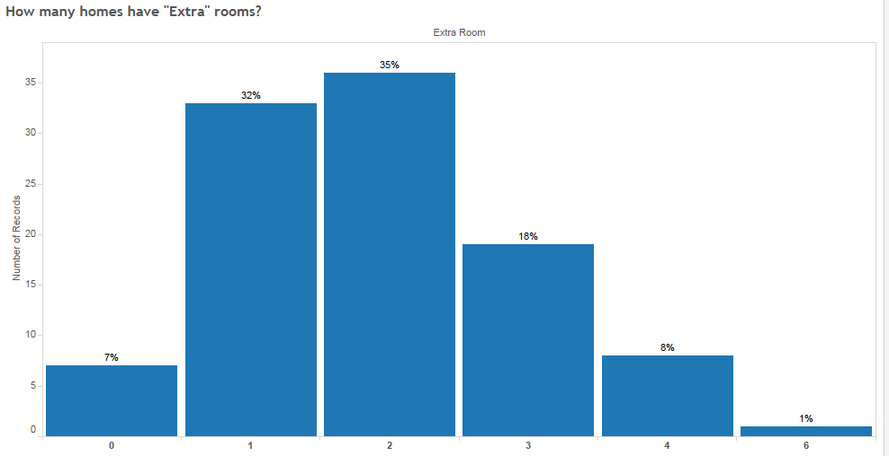
Numeric Calculation
How many homes have “Extra” rooms? How many extra rooms?
Extra rooms = No of rooms – No of bedrooms – No of bathrooms

Slide 4
Numeric Calculation
If “Acre” represents total area of the house including garden and “squarefeet” represents living area of house excluding garden then answer the following:
Which House Number has the highest Garden Area?
What is the Garden Area of House number “11” in sq. feet?
Which house number has highest Garden % (Garden area as percentage of Total Area)?
Hint – Convert acre in sq. feet (sq feet = Acre*43560)

Slide 5
Numeric Calculation - Answers
If “Acre” represents total area of the house including garden and “squarefeet” represents total area of house excluding garden then answer the following:
Which House Number has the highest Garden Area? (House 34)
What is the Garden Area of House number “11” in sq. feet? (10,465)
Which house number has highest Garden % (Garden area as percentage of Total Area)? (House 82)

Slide 6
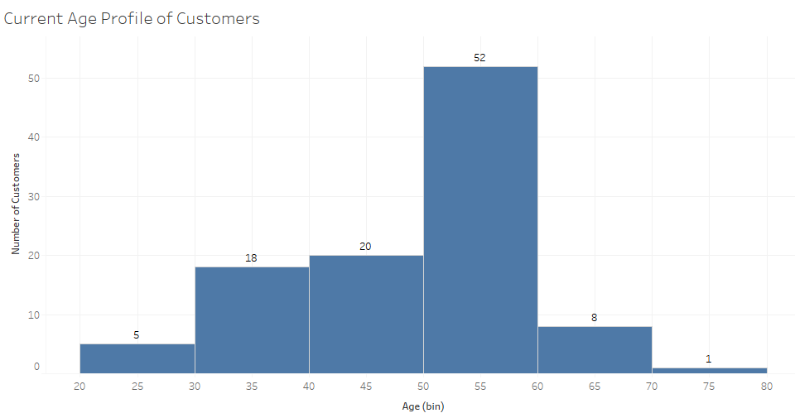
Date Calculation
What is the current age profile of our customers?

Slide 7
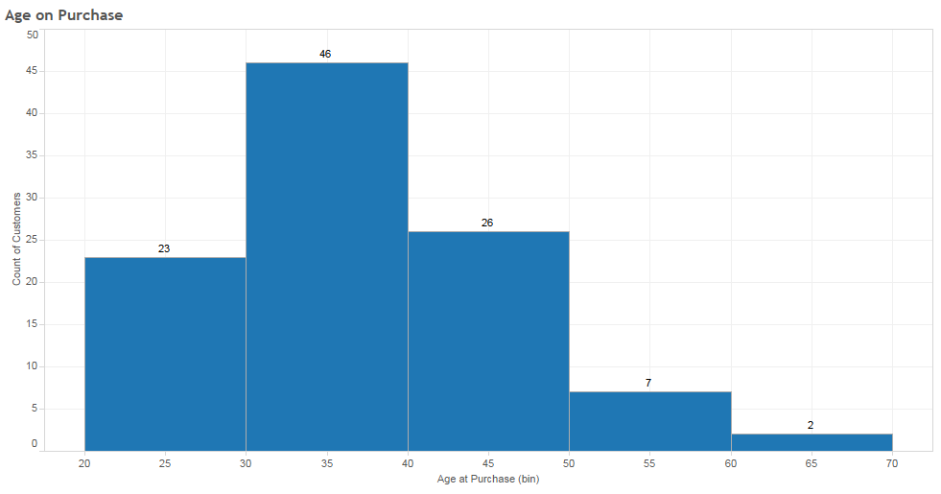
Date Calculation
At what age people are more likely to buy property?

Slide 8
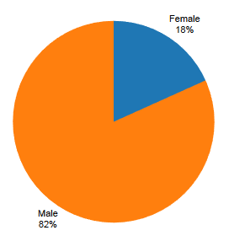
String Calculation
What percentage of customers are Male/Female?
Hint – One way is to use find and mid function on Name

Slide 9
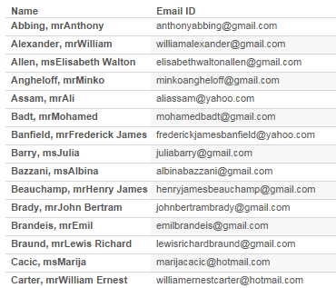
String Calculation
Create Email IDs of all customers (Sample below):
Hint – Do multiple custom split followed by right, len, + and lower function

Slide 10
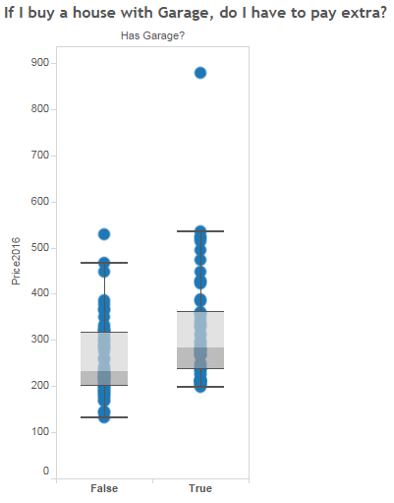
Logical Calculation

Slide 11
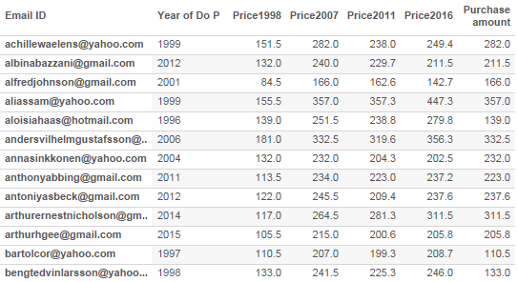
Logical + Date Calculation
Calculate purchase amount based on year of purchase:
If year of purchase matches the price year then use the same price year else use the next higher price year.
Hint – Required functions “year” and “if”

Slide 12
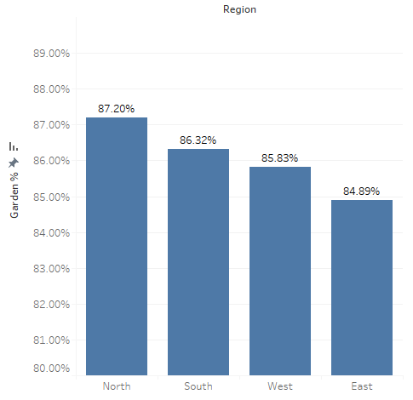
Aggregate Calculation
Which Region has highest “% Garden Area”?
Percentage Garden Area = Total Garden Area/Total Area

Slide 13
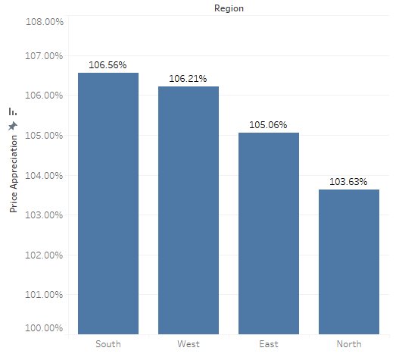
Aggregate Calculation
Which Region had highest Price appreciation since 1998 to 2016?
Price Appreciation = Difference in Price/Original Price (in 1998)

